Slide 1
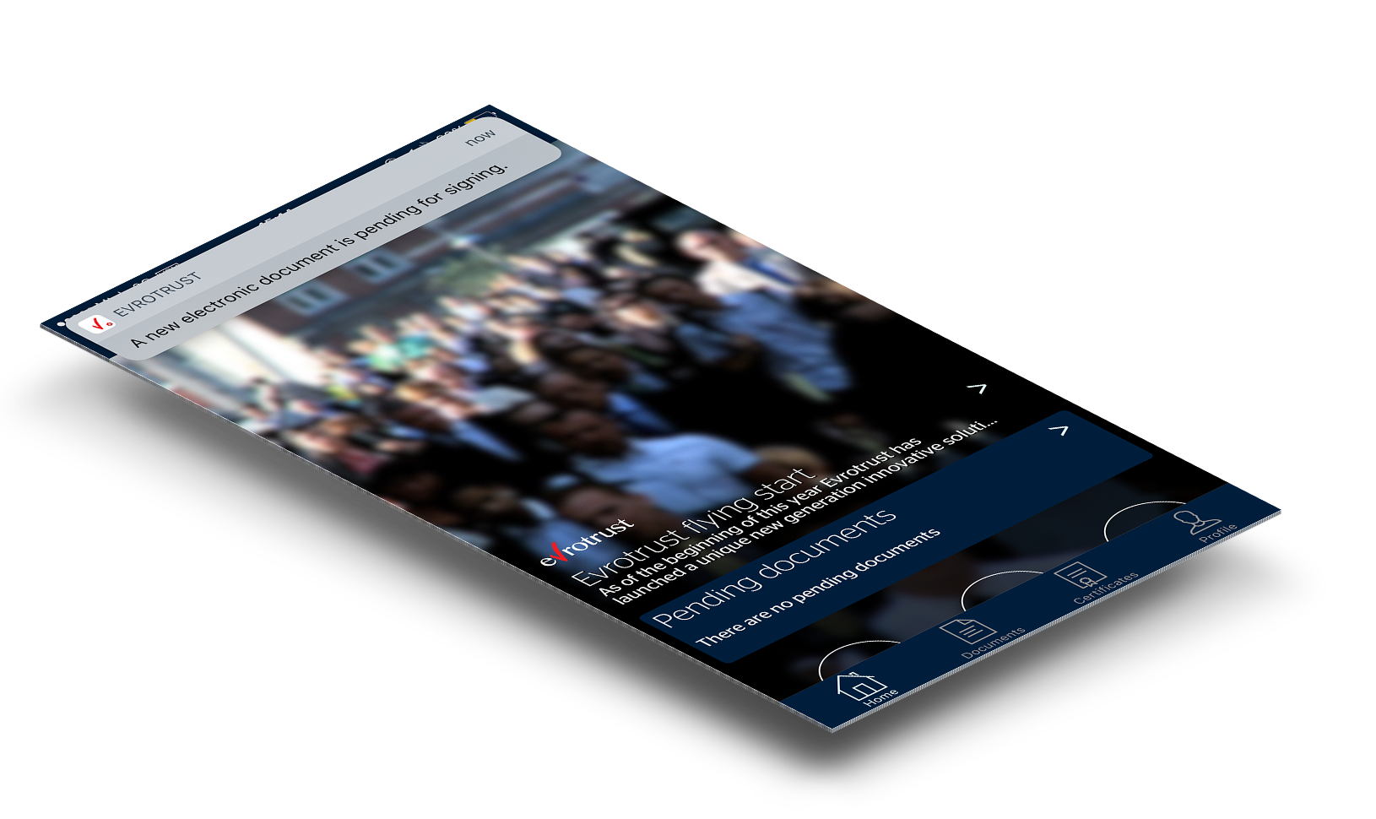
next generation e-identity and trust services

Slide 3
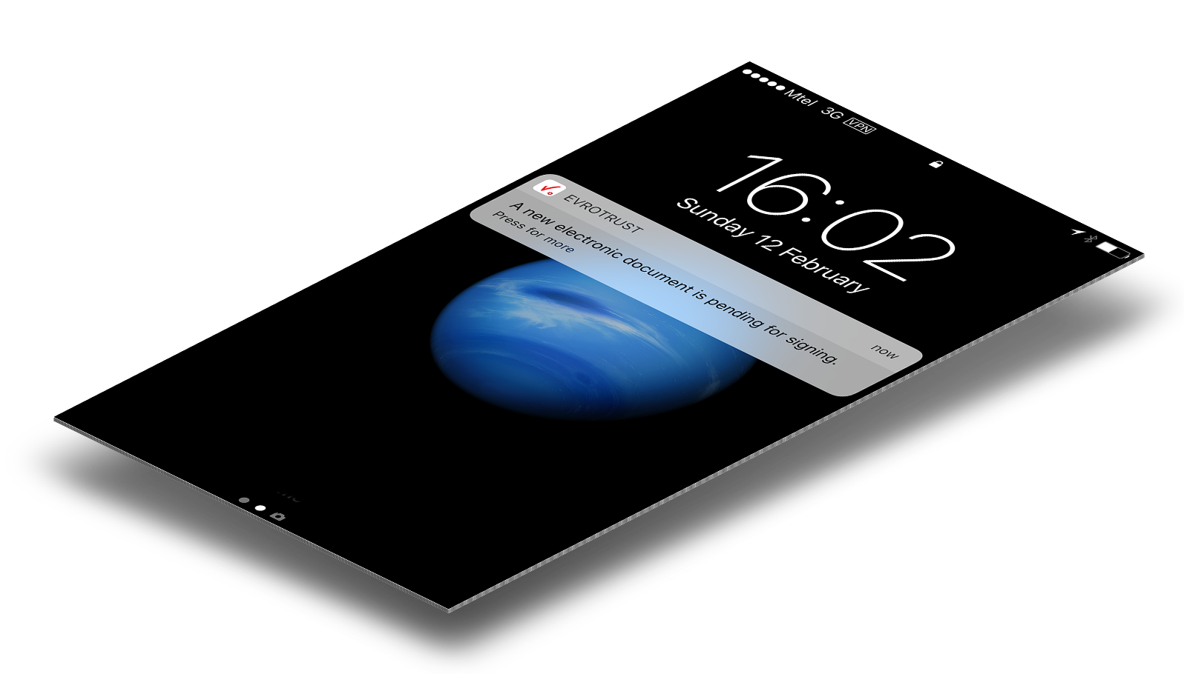
About us
Bulgaria-based technological company
High-tech product at launch
New generation Qualified Trust-Service-Provider
Compliant with European Regulation 910/EC
International conformity assessment audits eIDAS, ISO 27001, EN
Europe-wide recognized legally binding services
International business expansion plans
Innovative cloud-based remote e-signing and e-identity
Equates the legal value of digital documents to the paper-based signing
Liability insurance at premiere EU insurance company

Slide 4
Problem
No legal and technical solution to allow for fully digital and remote selling of products and services by banks, telecoms, insurance companies, government and other market players.
Legal
Legal aspects
No same legal value of the digital world as to the paper-based one with view to identification, signing, delivery of documents and time certification by now. Recently, a new legal base in EC - Regulation 910/2014/EC, has been enforced as of July 2017. It regulates the qualified eID, eSigning, eStamping, eDelivery and eTime-stamping with equivalent legal effect as those in the paper world, when provided by a Qualified Trust Service Provider.
digital world
≠
paper world
Technological aspects
Current technologies solutions are secure, but not technologically neutral. They require possessing of hardware (card readers, smart cards, tokens), technical knowledge, installation of drivers, certificate chains, dependency on platforms and browsers, and are not easily usable from smart devices. Moreover, they are not user friendly, which is a natural barrier for using qualified trust services. Some mobile technologies were also too much sophisticated for mass use and do not provide remote on the go solutions.
Technical
Current solutions – difficult to use and not remote

Slide 5
Product
one app to rule them all...
Remote e-identification
Smart remote video identification
Advanced face and emotion recognition
Integration with national ID database
Smart recognition of personal docs
Qualified attestation to third parties
Remote qualified e-signatures
Remote issuing of qualified certificates
Use from any smart device/platform
Remote managing of certificates
Remote signing of documents
All signed docs with qualified timestamp
Secure delivery of documents
In-app delivery
Qualified secure delivery
Legally recognised service
Immediate delivery
Sending any-to-any

Slide 6
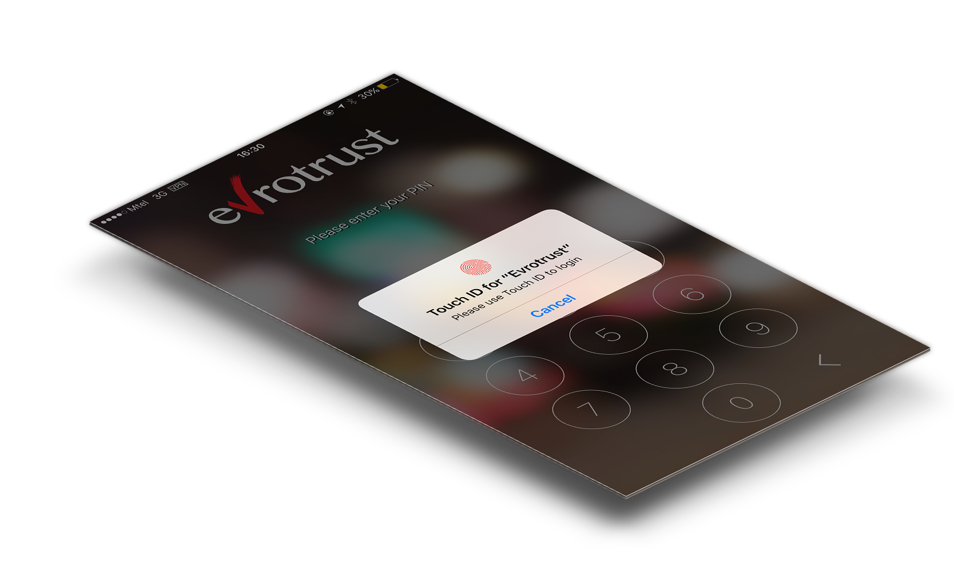
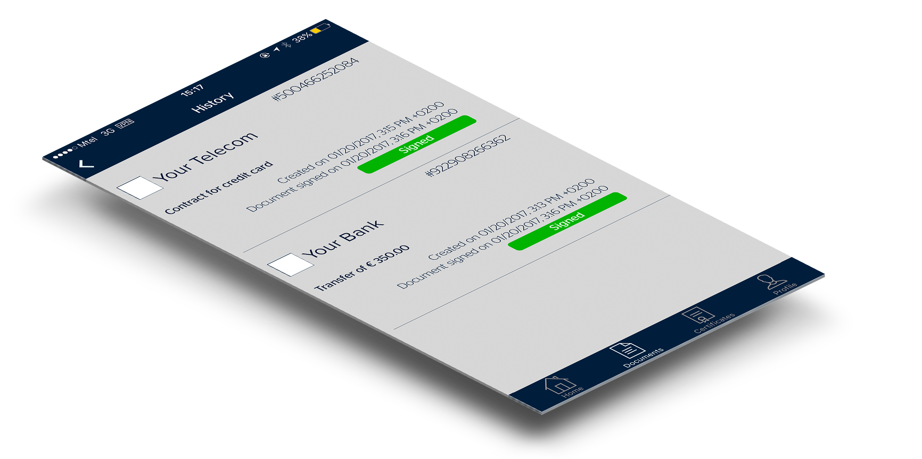
Product Uses
Enterprise Level – “Go fully digital”
Financial services (bank, insurance, online credits)
Telecom providers
Real-estate companies
Healthcare providers
Legal services
Gambling & other
Personal level – “Sign. Send. Manage.”
Personal/SME document workflow
Remote contract signing
Passwordless login
Healthcare data control
Credit card payment control
eGovernment services
Internet of things

Slide 7
Use Case - Remote Onboarding for Banks
Client chooses a product from the web and initiates remote purchase
Client receives a message with a link to download the co-branded app
Client undergoes a one-off 5 minute identification procedure and signs all documents with a click
Evrotrust verifies the identity, remotely issues a eSign and signs all documents that the bank requires to deliver the product
The bank receives qualified verification for the identity of the client and all documents signed with qualified eSignature. In this procedure Evrotrust bares all liability for the identification and signature

Slide 8
Use Case - Remote Onboarding for Banks
Current Problem
Evrotrust One-step Smart Solution
The Bank onboard users remotely in a user-friendly way, in line with the legal regulations.
The bank receives validly e-signed contract with the same legal value as paper-based.
The liability for identification and signing is outsourced.
The client saves time and money to visit bank offices.
The client uses the most accessible device that all people use - the mobile phone.
The bank optimizes substantial resources in keeping large branch network.
The bank may enroll users who are not geographically present in the country.
Added Value
All present legally allowed solutions for client onboarding involve physical presence of the client at a branch of the bank. This is limited by the locations and the working hours of the bank, as well as the available time and the location of the client. Appearance before bank is time-consuming and inconvenient both for the bank and the clients.
The bank can remotely onboard a new client and have him sign a contract at any time from any location.
The client is guided to install a co-branded app.
He is automatically video identified with the legal value of physical presence.
His ID document is checked for validity.
A qualified e-certificate is remotely issued.
The contract is remotely signed with a qualified signature having the same legal value of a handwritten signature.
The electronically signed contract is time-stamped and immediately delivered to the bank.
.... all in just 5 minutes from the mobile with a few clicks

Slide 9
Use Case - Remote eID for Credit Card Payments
Current Problem
Evrotrust One-step Smart Solution
Added Value
Fraud, malicious use and accidental loss of credit cards result in millions of damages for both banks and clients every year. All methods employed so far cannot stop unwanted use of credit cards. Statistics show even increasing trend especially in view of online credit cards payments. Using of different methods like 3D passwords prove not to be so efficient since they require additional knowledge and vulnerability. Follow-up notifications by SMS also does not resolve the problems due to their unreliability, post-transaction effect and cost.
Using Evrotrust app can solve the issue once the user is enrolled.
He can subscribe for preliminary confirmation before the credit card transaction takes place.
Once transaction event occurs either from ATM, POS or Internet, the bank pushes to the app request for confirmation.
Confirmation request is delivered immediately.
The client confirms the transaction from the app.
The bank processes the transaction.
Credit card payments might be also controlled from the user by integration with online payment websites.
The client controls the credit card transactions before they occur.
The bank shifts liability to the client since he authorizes the payments by explicit statement.
The delivery of the credit card transaction request and the response are secure and immediate.
The cost of the secure delivery of the request and the response and much cheaper than the SMS.
The client can immediately monitor all transaction from the app on the fly.
.... in just 1 click right the mobile

Slide 10
Use Case - Documents Delivery
Current Problem
Evrotrust One-step Smart Solution
Immediate delivery of documents and messages independent of place.
Delivered docs/messages can be presented in court with same legal value as handed over on paper by a notary public.
Docs can be sent for signing or for plain delivery.
The qualified delivery service is times cheaper then the paper delivery service.
Can be used for government or business purposes.
Added Value
Secure delivery of documents and messages with a value of material evidence has lead for many years to have this activity performed by special registered services like courier, postal services, notary publics or government delivery services. Hundreds of millions of documents like notices for default payments, contracts, invoices, etc., are delivered daily. The cost of the services is sometimes high. The time for delivery also differs and is dependent on the physical presence of the addressee.
The document/message is sent by the bank.
The message is pushed and delivered to the client immediately, right into the app.
Evrotrust certifies and delivers proof of delivery evidence with time for sending, sender, addressee, time for delivery and the content of the message/documents.
Messages can be also sent between all users of the application.
Documents are securely stored for 10 years and no one but the sender and the addressee can access and read them.

Slide 11
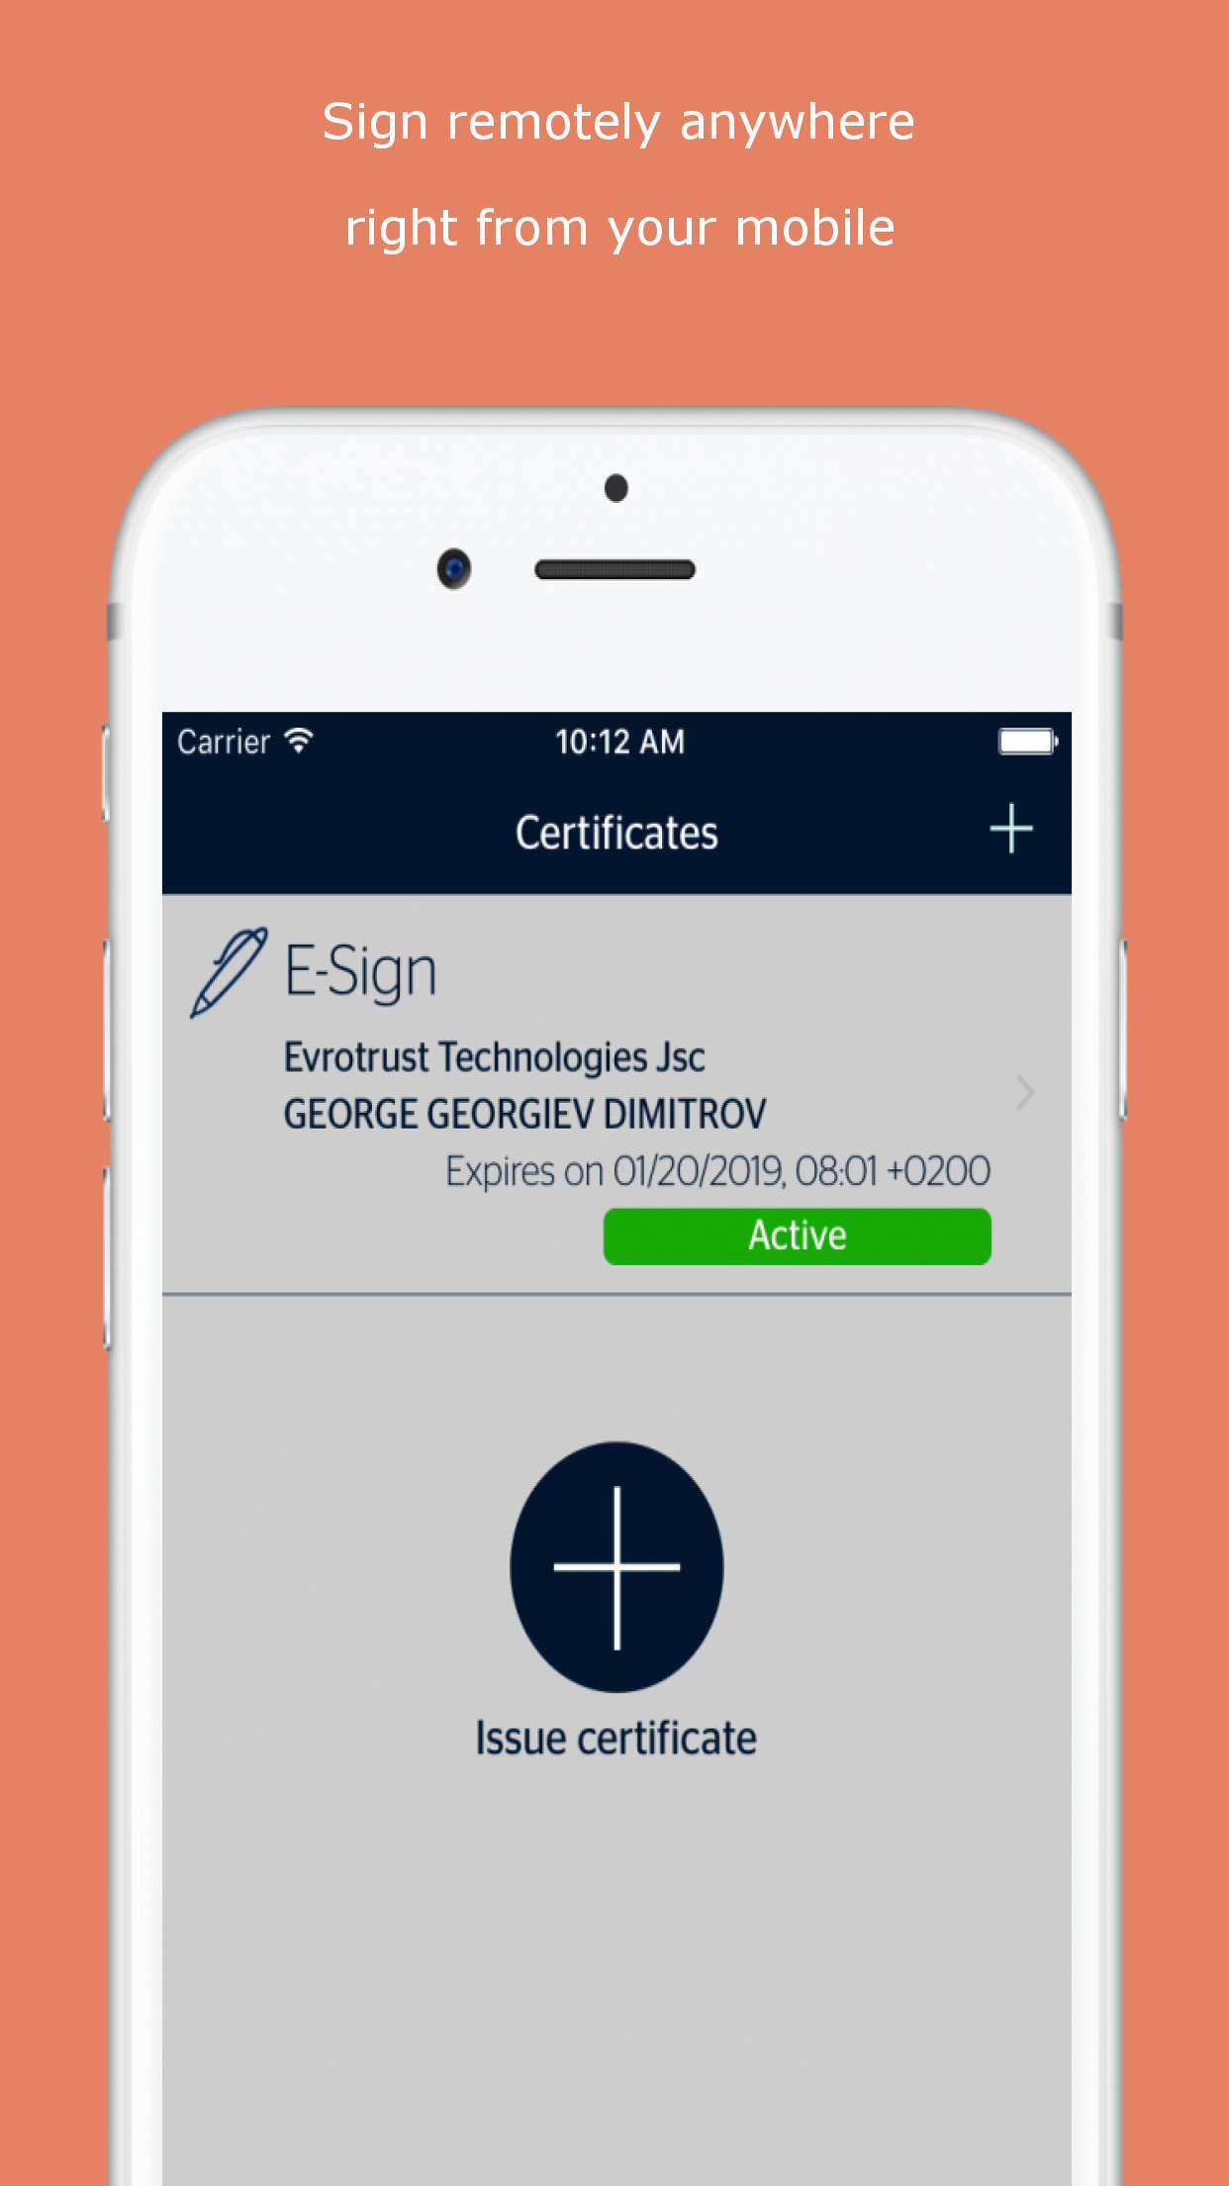
Advantages
All-in-one mobile app
Remote e-signature certificate management
Remote signing with qualified signatures
Remote video identification
Secure cloud HSM for private key storage
Dual channel concept encryption for highest security
Easy intuitive installation and profile creation within 10 minutes
Pay-per-use enterprise model
Subscription model for personal use
Billing settled with payment provider by choice
Qualified signatures = handwritten signatures
Qualified time-stamps = notary certification of date and time
Qualified secure delivery = notary handover
Qualified eID attestation before banks, government, etc.
Integration with the national eID schemes
Notes:
All-in-one mobile app – up to 70% penetration rate in Europe
Remote e-signature certificate management – easier communication with clients
Remote signing with qualified signatures – meeting “on-demand” demand
Remote video identification – securely verifies who you are talking to
Secure cloud HSM for private key storage - no loss when phone lost
Dual channel concept encryption for highest security
Easy intuitive installation and profile creation within 10 minutes
Pay-per-use enterprise model
Subscription model for personal use
Billing settled with payment provider by choice
Qualified signatures = handwritten signatures
Qualified time-stamps = notary certification of date and time
Qualified secure delivery = notary handover
Qualified eID attestation before banks, government, etc.
Integration with the Bulgarian national eID scheme

Slide 12
Benefits for the bank
Digital agenda: Solving the digital agenda of the bank in fast and user friendly remote ID of clients, remote signing of legally binding documents, secure delivery of documents and messages to correspondents and clients and complete paperless client management
Onboarding: Provide a legal and secure solution for complete remote customer onboarding through web or smart device
Respond to new trends: Offer full banking services through a new channel, in line with consumer behavior shifts due to increase in digital trends
Outsourced liability: Outsource the functions of remote identification to a third party provider
Legal evidence: Provide legal evidence for the interactions between the bank and its clients, recognized by Regulation of the EC throughout Europe (eIDAS)
Fin-tech alternative: Meeting the challenges of new fin-tech disruptions and promoting the bank as a virtual bank
Revenue stream: Benefit of profit sharing when clients of the bank use Evrotrust services
Compliance: Meeting the requirements of PSD2, eIDAS, RPDP, KYC
New services: Allow for provision of new quality services like complete telephone banking on-the-go

Slide 13
Benefits for the bank’s clients
Remoteness: A tool to enroll and use services from anywhere at anytime of the day without the need to go anywhere
Higher security: Amazing UX with higher security protection through 2FA for mobile/remote services
Identifications: Faster & more secure identifications during phone calls
Empowerment: Authorize other people to operate with an account with ease through Evrotrust’s digital empowerment register
Alternative method: Much better alternative in terms of UX and security to mTan, mobile Tokens, 3D passwords & SMS codes
eGoverment: Use qualified signatures for national eID & eGov services (at present - in Bulgaria only)
Passwordless login: Easier alternative for online banking login in by free passwordless login (no need to remember usernames and passwords – yet much more secure)

Slide 14
Thank you for your attention!
Q&A
Stefan Hadjistoytchev
Chief Technical Officer
stefan.hadjistoytchev@evrotrust.com
Evrotrust Technologies JSCo

